Slide 1
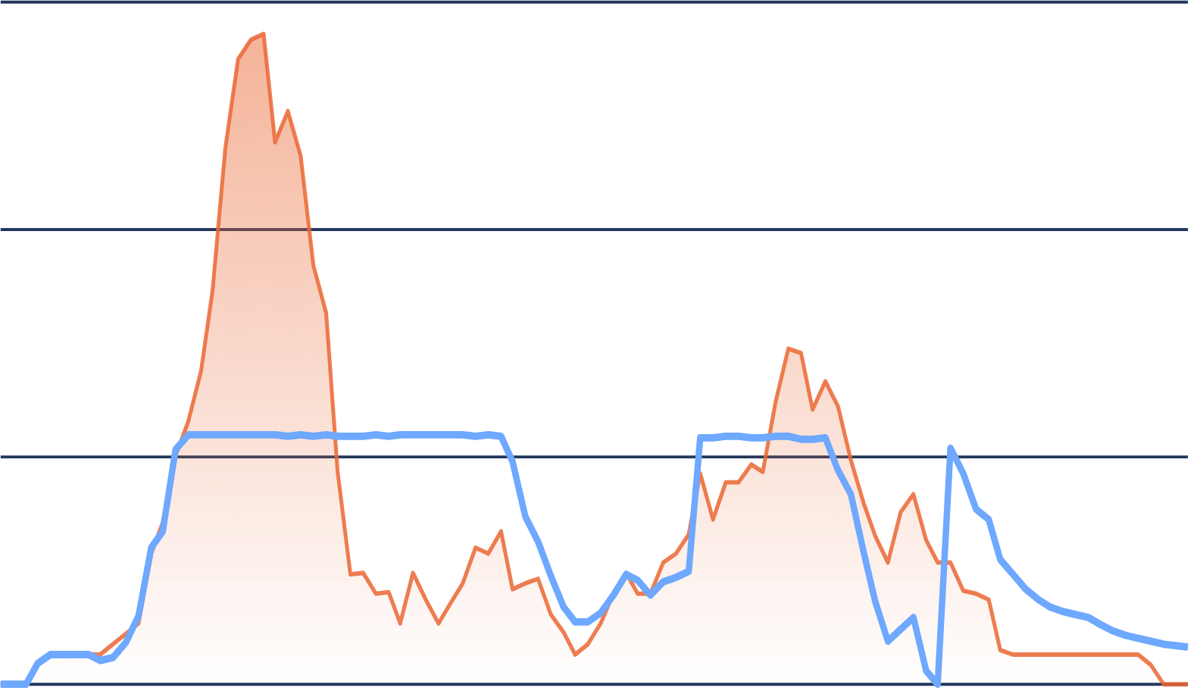
Grid-Aware Smart Charging Scheduling for EVs
CONVEX OPTIMIZATION · COURSE PROJECT
A Convex Optimization Approach
1,772 real charging sessions
LP · QP · SOCP · SAA
−26% monthly bill
Group 1 · Tarun Thomas Tom · Milan V Raj · Nirmal Thomas Mathew
[Course name] · [Date]
Notes:
[Tarun · ~10 s] Hi, we’re Group 1: Tarun, Milan and Nirmal. Our project is grid-aware smart charging for electric vehicles, posed as a convex optimization problem and tested on real charging data from Caltech. I’ll set up the problem and the model, Milan will show the results on the monthly bill and with predicted driver data, and Nirmal will cover solar and our takeaways.

Slide 2
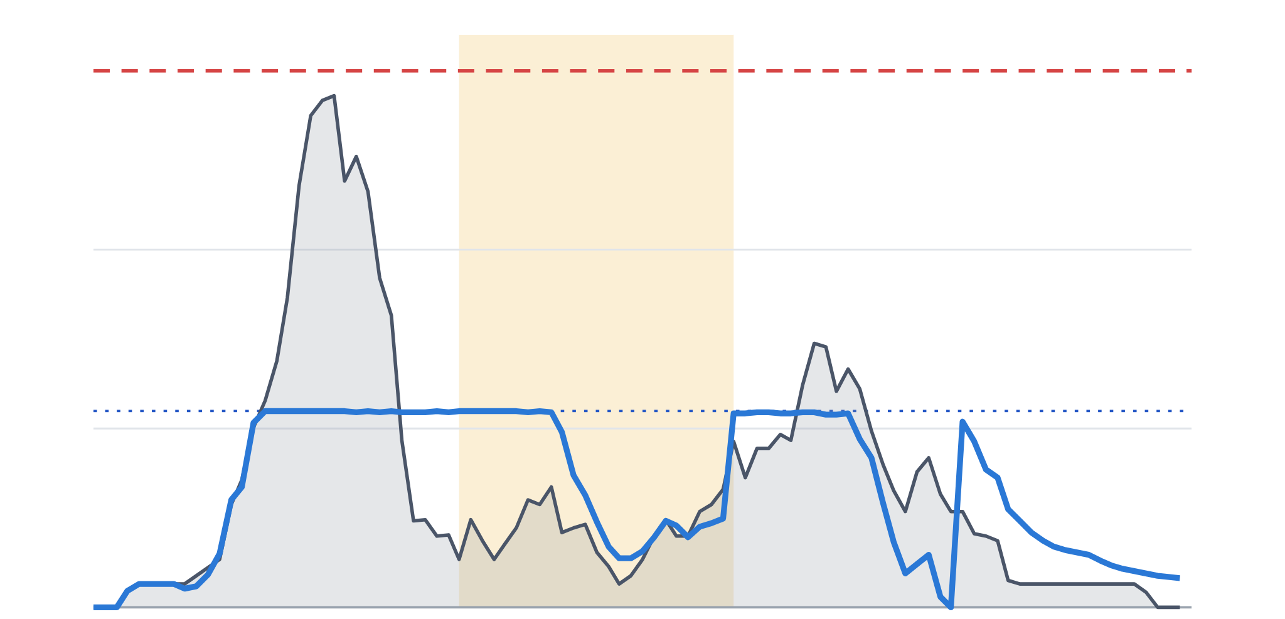
Charging on arrival spikes the peak
01 · THE PROBLEM
kW
54 chargers
150
Charge on arrival · 143 kW
Transformer limit · 150 kW
3 phases behind one 150 kW transformer, Caltech ACN garage
On-peak price
12:00–18:00
100
1,772 sessions
Smart charging (MPC)
held at P* = 55 kW
real charging data, 19 weekdays of September 2018
50
$15.51 / kW
0
on the month’s highest 15-min peak, on top of time-of-use energy
6:00
9:00
12:00
15:00
18:00
21:00
0:00
3:00
5 Sept 2018, 15-min average load · ACN-Sim · SCE TOU-EV-4 tariff
2
Notes:
[Tarun · ~50 s] We used real data from the Caltech ACN garage: 54 chargers on three phases behind one 150 kW transformer, and 1,772 charging sessions from the 19 weekdays of September 2018. The grey curve is one day, 5 September, with every car charging at full rate as soon as it plugs in. Everyone arrives around 9, so the load spikes to about 143 kW, right at the transformer limit. That spike is expensive. The tariff charges $15.51 per kW on the month’s single highest 15-minute peak, on top of time-of-use energy prices. But most cars stay parked for hours, so the charging can wait. The blue line is our controller on the same cars: it holds the load at the 55 kW target. The question is how to use that flexibility optimally.

Slide 3
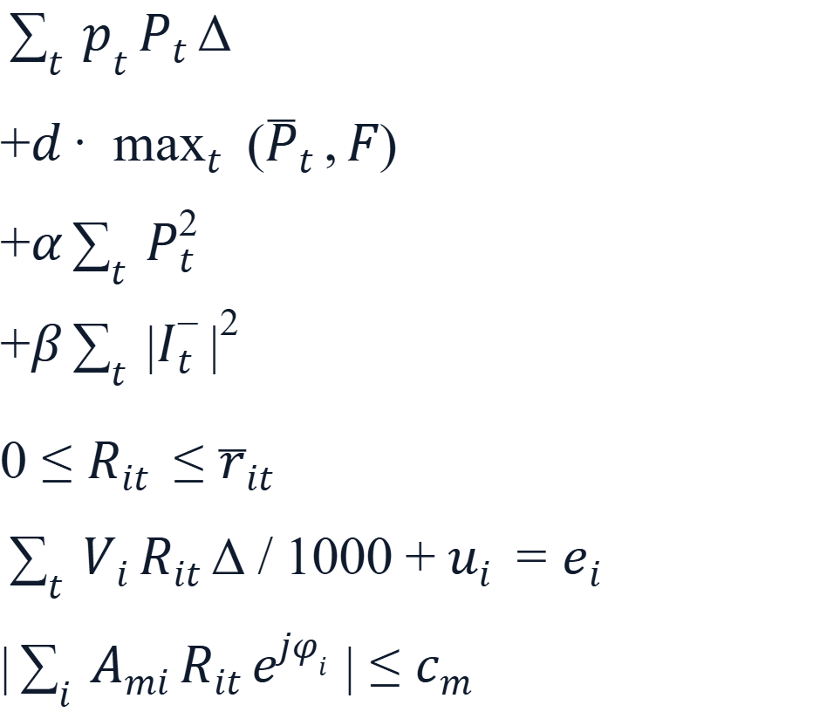

One convex model, every 5 minutes
02 · THE MODEL
minimize
TOU energy
LP
What we run
demand charge
LP
MPC re-solves every 5 min over the next 12 h and applies only the first step.
valley filling
QP
MPC-Bill-LP
phase balance
QP
energy + demand charge
MPC-Combined-QP
subject to
plug-in window
LP
+ valley filling + phase balance
energy need (soft)
LP
OPT (benchmark)
same model, whole month, perfect information
network limits
SOC
Convex, so a global optimum · median solve 0.04–0.09 s with CVXPY + Clarabel
Then we add realism, one step at a time:
S2 · Real monthly bill
S3 · Predicted drivers
S4 · On-site solar
R_it = charging current of EV i in period t · 5-min periods · horizon capped at 144 periods (12 h)
3
Notes:
[Tarun · ~60 s] We solve one convex program. The decision R is the charging current of each EV in each 5-minute period. The objective adds up to four terms. Time-of-use energy cost and the demand charge on the 15-minute peak are linear; F carries the month’s peak so far into each day. Valley filling and phase balance are quadratic. The constraints: an EV only charges while it is plugged in. Its energy need is a soft equality with a priced slack u, because the hard version was infeasible in about 35 calls a day. And the three-phase network limits are exact phasor magnitudes, which are second-order cones. So it is an LP or a QP with cone constraints: a global optimum, solved in under a tenth of a second at the median. We run it as MPC: re-solve every 5 minutes over 12 hours and apply the first step. OPT is the same model solved once for the whole month with perfect information, which is our benchmark. We compare two objectives, Bill-LP and Combined-QP, and then add realism step by step: a real monthly bill, predicted driver data and on-site solar. Milan will take the results.

Slide 4
MPC cuts the monthly bill by 26%
03 · S2 · REAL MONTHLY BILL
SEPTEMBER BILL
PEAK
Uncontrolled
$4,845
192 kW
MPC-BILL-LP VS EDF
breaks network limits
−26%
EDF
$4,116
144 kW
best standard heuristic
$4,116 → $3,031
MPC-Combined-QP
$3,518
78 kW
144 → 70 kW
ours · also flat + balanced
billed 15-min peak, halved
OPT-Bill-LP
$3,150
71 kW
19.9 vs 20.6 ¢
perfect-info benchmark
per kWh delivered: MPC vs the perfect-information OPT
MPC-Bill-LP
$3,031
70 kW
ours · cheapest
Sept 2018, 19 weekdays, known driver data · bill = TOU energy + $15.51/kW × highest 15-min peak
4
Notes:
[Milan · ~60 s] First step up the ladder: the real September bill, still with perfect information about the drivers. Charging on arrival costs $4,845, and it breaks the network limits, at about twice a limit at worst. The best of the standard heuristics, earliest-deadline-first, respects the limits but still pays $4,116, because it does nothing about the peak. Our MPC-Bill-LP brings the bill down to $3,031, which is 26% less, mainly by halving the billed peak from 144 to 70 kW. Combined-QP costs a bit more because it also pays for a flat load and balanced phases. The perfect-information optimum, OPT, is not actually better per kilowatt-hour delivered: 20.6 cents against our 19.9. The MPC delivers slightly less energy, 98.9% against 99.6%, because of battery tapering, so we always compare cents per kWh and not just the bill.

Slide 5



Scenarios fix what predictions break
04 · S3 · PREDICTED DRIVER DATA
MEDIAN
CONSERVATIVE
SAA-30 · OURS
Plan for the typical driver
Assume short stays, big requests
Hedge over 20 past outcomes
Combined-QP · $2,782
76.4%
Combined-QP · $3,178
96.3%
Combined-QP · $3,470
94.3%
Bill-LP · $2,924
92.3%
Bill-LP · $3,197
97.7%
Bill-LP · $3,261
97.9%
Looks cheap only because 8–24% of the energy never arrives
Delivers 96–98% and costs less than Conservative
Delivers, but peaks grow to 80–90 kW and the bill rises
Expected unmet energy over ≤ 20 past (stay, kWh) scenarios per EV. Still an LP. w = 30 $/kWh, chosen in-sample.
Predictions from the previous 28 weekdays · bar = share of requested energy delivered · tick = 95%
5
Notes:
[Milan · ~60 s] In reality the controller does not know when a driver will leave or how much energy they need. We predict both from the previous four weeks of history. If we plan for the typical driver, the median, the MPC looks cheap, but that is an illusion. Combined-QP delivers only 76% of the energy, because median requests undercount daily demand by about 10%. Being conservative, assuming short stays and big requests, fixes delivery, but the peak grows to 80 to 90 kW and the bill goes up. Our fix is a sample average approximation. Each EV carries up to 20 historical scenarios of how long it stays and how much it needs, and we penalise the expected unmet energy with a hinge. The hinge is linear, so the problem stays convex. With a weight of 30 dollars per kWh, both MPCs deliver 96 to 98% and cost less than the conservative version. One caveat: we chose that weight on the same month. Nirmal will take solar.

Slide 6
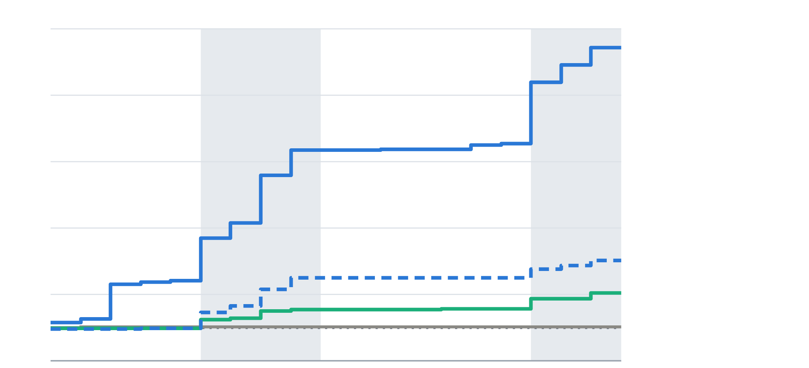
Solar exposes a fragile objective
05 · S4 · ON-SITE SOLAR (50 KW)
Month-to-date billed import peak (kW), September 2018 weekdays
BEST ONLINE CONTROLLER
100
Combined-QP+F · SAA-30
partly cloudy
97 kW
$1,904
September bill
90
Bill-LP, perfect info
60.2 kW
import peak
80
97.8%
delivered
OPT with known solar: $1,675
70
Bill-LP, SAA-30
65 kW
60
Combined-QP+F, SAA-30
60 kW
Why Bill-LP ratchets
55 kW
It fills import exactly to the peak already paid for, so each solar-forecast miss ratchets it up.
50
OPT, known solar ≈ P* (55 kW)
Sep 4
Sep 10
Sep 17
Sep 24
Sep 28
50 kW PV behind the meter · bill on net import · synthetic weather · shaded = partly cloudy days
6
Notes:
[Nirmal · ~60 s] Last step: a 50 kW solar array behind the meter, so the bill is on net import, and the controller only has a solar forecast. This chart is the billed import peak so far in the month. The surprise is the solid blue line: Bill-LP, even with perfect driver information, ratchets its peak from 56 to 97 kW. It plans to import exactly up to the peak it has already paid for, so every time the solar forecast falls short, mostly on the partly cloudy days shaded here, the peak goes up. A monthly peak never comes back down. Scenarios help here too. SAA charges earlier and leaves a solar buffer, which holds Bill-LP at 65 kW. Our best online controller is Combined-QP with an arrival forecast and SAA: $1,904, 60 kW and 97.8% delivered, against $1,675 for the optimum that knows the solar in advance. To be honest, the forecast adds only $15 over plain Combined-QP with SAA. Its main lesson was a horizon-edge bug in MPC that we found and fixed.

Slide 7

Three things we learned
06 · TAKEAWAYS
REAL MONTHLY BILL
PREDICTED DRIVERS
ON-SITE SOLAR
−26%
76 → 96%
97 → 60 kW
Convex MPC beats the best heuristic and respects every network limit.
A convex scenario (SAA) term restores delivery, for less than guessing conservatively.
Filling to the paid-for peak is fragile. Flattening plus scenarios holds it near target.
Every solve fits the 5-minute step: median 0.04–1.3 s, worst case 21 s of 300 s.
Limits: one month at one site · synthetic solar weather · SAA weight chosen in-sample · continuous charging rates
Questions?
Group 1 · Tarun Thomas Tom · Milan V Raj · Nirmal Thomas Mathew
7
Notes:
[Nirmal · ~50 s] Three takeaways. One: on the real monthly bill, a convex MPC cuts cost by 26% against the best heuristic while respecting every network limit. Two: predicted driver data breaks a deterministic MPC, and a convex scenario term restores delivery to 96 to 98%, at lower cost than conservative guessing. Three: with solar, an objective that fills exactly to the peak it has paid for is fragile. Flattening plus scenario front-loading holds the import peak near target, 60 kW instead of 97. And everything solves well inside the five-minute step: 21 seconds in the worst case, out of 300. Limitations: this is one month at one site, the solar weather is synthetic, and the SAA weight was chosen on the same month. Thank you, we’re happy to take questions.

Slide 8
Every solve fits the 5-minute step
BACKUP · SOLVER
Setup | Controller | Solves | Median / P99 / max (s)
S2 Month | MPC-Bill-LP | 6,996 | 0.09 / 2.29 / 3.8
S2 Month | MPC-Combined-QP | 9,440 | 0.08 / 2.37 / 5.1
S3 Median | MPC-Combined-QP | 6,999 | 0.04 / 0.52 / 1.0
S3 SAA-30 | MPC-Bill-LP | 6,343 | 0.10 / 6.97 / 8.9
S3 SAA-30 | MPC-Combined-QP | 6,351 | 0.15 / 8.27 / 10.3
S4 SAA-30 | MPC-Combined-QP+F | 6,351 | 1.31 / 12.79 / 21.4
S2 Month | OPT-Bill-LP (one joint 19-day solve) | 1 | 595
S2 Month | OPT-Combined-QP (one joint 19-day solve) | 1 | 1,031
CVXPY + Clarabel (interior point, SCS as fallback). 0 infeasible schedules and 0 fallbacks in every MPC month. SAA solves are ~15× slower because the running-total chain fills in the KKT system.
Wall time per scheduler call (model build + compile + solve), 10–12 jobs in parallel · control period 300 s
B1
Notes:
Backup for questions on computation. Deterministic MPC solves in well under a second at the median. SAA adds scenario variables whose running totals cause fill-in in the KKT factorisation, so it is about 15 times slower, but even the slowest variant, Combined-QP+F with SAA, has a worst case of 21 s against the 300 s control period. The OPT benchmarks are single joint solves over all 19 days: about 10 and 17 minutes.

Slide 9
Every information level, S3 and S4
BACKUP · FULL RESULTS
S3 · predicted driver data
S4 · 50 kW solar, net import billed
Info | Controller | Bill | kW | Deliv.
Median | EDF | $4,059 | 140.5 | 99.7%
Median | Bill-LP | $2,924 | 54.9 | 92.3%
Median | Combined-QP | $2,782 | 62.1 | 76.4%
Cons. | Bill-LP | $3,261 | 79.7 | 97.9%
Cons. | Combined-QP | $3,470 | 89.9 | 94.3%
SAA-30 | Bill-LP | $3,197 | 72.6 | 97.7%
SAA-30 | Combined-QP | $3,178 | 68.2 | 96.3%
Info | Controller | Bill | kW | Deliv.
Perfect | Bill-LP | $2,514 | 97.2 | 98.6%
Perfect | Combined-QP | $2,235 | 66.0 | 96.7%
Median | Bill-LP | $2,235 | 87.0 | 84.3%
Median | Combined-QP | $1,629 | 54.9 | 75.8%
Cons. | Bill-LP | $2,360 | 88.7 | 97.4%
Cons. | Combined-QP | $2,173 | 77.2 | 93.9%
SAA-30 | Bill-LP | $1,994 | 65.1 | 98.2%
SAA-30 | Combined-QP | $1,919 | 61.5 | 97.3%
SAA-30 | Combined-QP+F | $1,904 | 60.2 | 97.8%
Perfect | OPT-Bill-LP | $1,675 | 55.1 | 99.6%
Low Median bills come from undelivered energy, so read them with the delivery column.
SAA-30 beats Perfect in S4 because it front-loads charging and leaves solar surplus to absorb forecast dips, not because it knows more.
September 2018 · bill = energy (or net import) + $15.51/kW × highest 15-min peak · kW = billed peak
B2
Notes:
Backup for questions on specific numbers. All bills include the demand charge. Always read a bill together with delivery: Median looks cheapest in both setups only because 8 to 24% of the requested energy is never delivered. In S4, SAA-30 even beats the perfect-information MPC on the bill. That is not better information: SAA front-loads charging, which leaves solar surplus later in the day to absorb forecast dips. The arrival forecast (+F) improves Combined-QP SAA-30 by only $15 and 1.3 kW.

Slide 10
Robust LP: a cheaper worst case
BACKUP · ROBUST EXTENSION (S1 DAILY)
Formulation
WORST-CASE DAILY COST
Bertsimas–Sim budget Γ_price on the TOU prices, dualised into extra LP variables.
Per-period solar protection Γ_solar ∈ [0, 1] on clear-sky PV ± 40%.
A solar budget across time has no LP counterpart: its worst case maximises a convex function.
Daily setting only, with a different PV model from S4.
−12.5%
$65.6 → $57.4 per day at Γ_solar = 1, Γ_price = 12, with no loss in the forecast case ($49.8 → $49.5)
MPC-Bill-LP (daily) · 50 kW clear-sky PV ± 40% · net energy cost, mean over 5 days
B3
Notes:
Backup for questions on robustness. We made the daily Bill-LP robust in two ways. Price uncertainty uses a Bertsimas–Sim budget, which dualises into an LP. For solar, a budget that limits how many periods can deviate has no LP counterpart, because the worst case means maximising a convex function, so we protect each period separately with Γ_solar. With full solar protection and a price budget of 12, the worst-case daily cost drops 12.5%, from $65.6 to $57.4, at no cost in the forecast case. This is only in the simple daily setting with clear-sky PV, so it is not comparable to the S4 numbers.

